Slide 1
C++ Programming – Classes
Michael Griffiths
Corporate Information and Computing Services
The University of Sheffield
Email m.griffiths@sheffield.ac.uk

Slide 2
Presentation Outline
Differences between C and C++
Object oriented programming
Classes
Data Abstraction

Slide 3
C++ As “Better” C
More robust
  Stronger type checking
Hides complexity
Enables user-extensible language

Slide 4
C++ ANSI Standard
Standard library
Standard Template library
  Wide range of collection classes
Exception handling
Namespaces

Slide 5
Standard Library
Header file names no longer maintain the .h extension typical of the C language and of pre-standard C++ compilers
Header files that come from the C language now have to be preceded by a c character in order to distinguish them from the new C++ exclusive header files that have the same name. For example stdio.h becomes cstdio
All classes and functions defined in standard libraries are under the std namespace instead of being global.

Slide 6
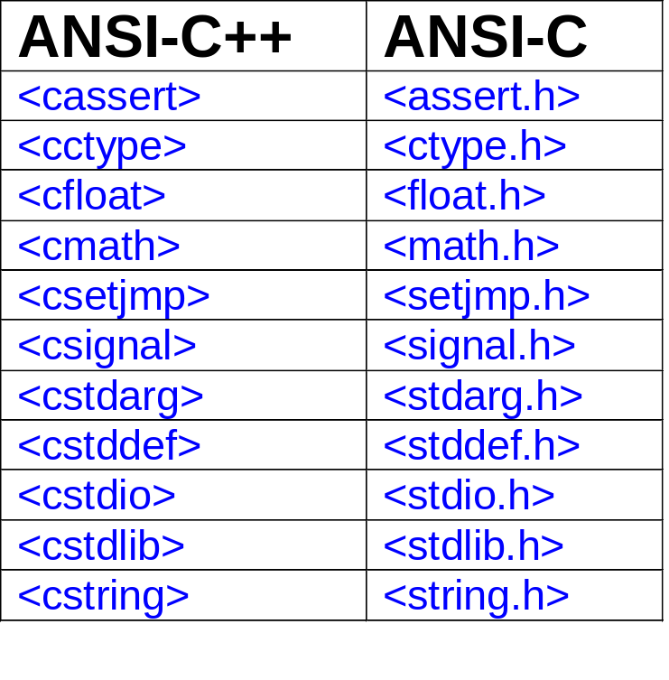
ANSI C Libraries and ANSI C++ Equivalents

Slide 7
Features
Comments
Stream input and output
Constants
  The const keyword
Declarations as statements
Inline expansion
References

Slide 8
More Features
Dynamic memory allocation (new and delete)
Function and operator overloading
User defined types
Data abstraction and encapsulation
  Use classes to incorporate new types
Scoping and the Scope Resolution Operator
Template

Slide 9
Comments
Traditional C comment (can be used in C++)
  /*This is a traditional C comment*/
C++ Easier comment mechanism
  //This is a C++ comment

Slide 10
Stream Input and Output
C++ Provides operators for input and output of standard data types and strings
  Stream insertion operator <<
    Alternative to printf
  Stream extraction operator >>
    Alternative to scanf
To use C++ stream operators include the header iostream

Slide 11
Stream Input and Output Examples
cout<< “Hello World\n”;
  Displays Hello World
  Note use of the escape characters used in C
cin>>a>>b;
  Assigns data read from the input stream to the variables a and b
Can still use printf and scanf but it is not good to mix usage of these with stream operators

Slide 12
Reading Files Using ifstream
#include <iostream>
#include <fstream>
using namespace std;
int main ()
{
  ifstream infile;
  infile.open ("test.txt", ifstream::in);
  while (infile.good()) cout << (char) infile.get();
  infile.close();
  return 0;
}

Slide 13
Using ofstream to Write To Files
// ofstream::open
#include <fstream>
using namespace std;
int main ()
{
  ofstream outfile;
  outfile.open ("test.txt", ofstream::out | ofstream::app); outfile << "This sentence is appended to the file content\n";
  outfile.close();
  return 0;
}

Slide 14
The const keyword
In C constants normally defined using
  #define PI 3.14159265358979323846
In C++ use the const keyword
  Declare any variable as const
  const double PI = 3.14159265358979323846;
A const object may be initialized, but its value may never change.

Slide 15
Advantages of Using const
Allows the compiler to ensure that constant data is not modified generate more efficient code
Allows type checking

Slide 16
Classes
Data Abstraction
Data encapsulation
Data hiding
Objects

Slide 17
Encapsulation and Abstract Data Types (ADT)
Model defines an abstract view of a problem
Represent model as a collection of abstract data types
Abstract Data type
  Abstract data structure
  Operations defining an interface
Operations of the interface are the only ones allowing access to the types data structure

Slide 18
Primary Characteristics of Object Oriented Programs
Encapsulation
  Mechanism for enforcing data abstraction
Inheritance
  Allow objects to be derived from previously defined objects
Polymorphism
  Different types of objects respond to the same instruction to perform a method that is specific to the particular kind of object

Slide 19
Object Oriented Programming (OOP)
Successful OOP is dependent on good design, this means
  Selecting classes that are relevant that provide the solution for the particular problem under investigation
  Always try and get the right class structure for the application
  In the software lifecycle sometimes necessary to refine classes and introduce new classes

Slide 20
Object Oriented Design
Use OO design techniques such as UML (Unified Modelling Language)
  Use Case Modelling
  Class diagrams
  Sequence diagrams
  Activity diagrams
Aim to minimise the number of iterations in the development cycle

Slide 21
Classes
Class is a data type
Like a structure but includes
  Methods i.e. functions to manipulate the members
An object is an instantiation of a class
Each Class instantitation i.e. each object
  Own copy of data members
  Share methods with objects of same type

Slide 22
Class Declaration
class classname {
public:
classname();
~classname();
vartype m_var;
vartype method(var list);
private:
private members and methods here
}

Slide 23
Member Functions
Constructor function
  Methods to perform when object created
  Initializes object data
Destructor function
  Methods to perform when object destroyed
  Frees any memory used by the object

Slide 24
Data Member Types
public (default)
  Members declared as public can be used by any other objects
private
  Members declared as private can only be read, written by members of this class
protected (see later)
  Data members can be accessed by members of this class and classes that are derived from this class

Slide 25
Simple Class Declaration
//Program8.cpp
//C++ Class example illustrating
//class constructors and destructors
#include <iostream>
#include <cstring> //strcpy and strlen
class WrgComputeNode {
public:
WrgComputeNode(const char *sName ); //Constructor
~WrgComputeNode(); //Destructor
char *GetName(){ return m_sName; }
private:
char *m_sName;
};

Slide 26
Member Functions for WrgComputeNode Class
Function name preceeded by class name and a scope resolution operator
WrgComputeNode::WrgComputeNode(const char *sName )
{
m_sName = new char [strlen(sName)];
strcpy(m_sName, sName);
}
//Delete memory that was allocated for the
//creation of the node name
WrgComputeNode::~WrgComputeNode()
{
delete [] m_sName;
}

Slide 27
Using Classes
Initialising an object
WrgComputeNode Sheffield("Titania");
WrgComputeNode Leeds1("Maxima");
WrgComputeNode York("Pascali");
Accessing Members and Calling Methods
cout << "Sheffield grid node is " << Sheffield.GetName() <<endl;
cout << "Leeds grid node 1 is " << Leeds1.GetName() << endl;
cout << "York grid node is " << York.GetName() << endl;

Slide 28
Class Constructors and the new Operator
In C++ the new function takes the place of malloc().
To specify how the object should be initialized, one declares a constructor function as a member of the class,
  Name of the constructor function is the same as the class name
Methods for declaring a stack class
stack s1(17);
stack *s2 = new stack(2);

Slide 29
Destructors and the delete operator
Just as new is the replacement for malloc(), the replacement for free() is delete.
To get rid of the Stack object we allocated above with new, one can do:
delete s2;
This will deallocate the object, but first it will call the destructor for the Stack class, if there is one.
This destructor is a member function of Stack called ~Stack()

Slide 30
Stack class definition
class stack{
public:
stack(int sz=10);
~stack();
void push(int value);
int pop();
public:
int m_size;
int m_count;
int *m_stack
};

Slide 31
Stack constructor
stack::stack(int sz)
{
m_size=(sz>0?sz:10);
m_stack = new int[m_size];
m_count=0;
}

Slide 32
Stack destructor
stack::~stack()
{
delete [] m_stack;
cout << "Stack deleted." << endl;
}

Slide 33
Example of Using the stack class
int main()
{
stack s1(17);
stack *s2 = new stack(2);
s1.push(5);
s2->push(8);
s2->push(7);
//pop items from the stack
cout << "Popping stack s1 gives " << s1.pop() << endl;
cout << "Popping stack s2 gives " << s2->pop() << endl;
cout << "Popping stack s2 gives " << s2->pop() << endl;
cout << "deleting stack s2: ";
delete s2;
return 0;
}

Slide 34
Inheritance
Inheritance is a mechanism by which base classes can inherit data and methods from a base class
The new class is called a derived class
An object of a derived class may be treated as an object of the base class

Slide 35
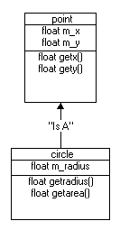
A Shape Defined by A Object Defining its Position

Slide 36
Base Class Definition
class point {
public:
point(float x=0, float y=0); //Default constructor
void setpoint(float x, float y);
float getx() const {return m_x;}
float gety() const {return m_y;}
protected: //accessible only by derived classes
float m_x;
float m_y;
};

Slide 37


Derived Class Definition
class circle : public point { //circle inherits from point
public:
circle(float r, float x, float y); //default constructor
void setradius(float r);
float getradius() const;
float getarea() const;
protected:
float m_r;
};

Slide 38
Creating Instances
point *pointPtr;
point p(2.1, 3.2);
circle *circlePtr;
circle c(3.2, 1.7, 3.9);
pointPtr = (point *) &c;
circlePtr = &c;

Slide 39
Calling Object Methods and Members
cout << "Point p: x=" << p.getx() << " y=" << p.gety() << endl;
cout << "Circle c: radius=" << c.getradius() <<" x=" << c.getx()
<< " y=" << c.gety() << " area=" << c.getarea() << endl << endl;

Slide 40
Treating a circle object as a point object
cout << "Using point pointer to access circle base class information"
<< endl;
cout << "Circle c: x=" << pointPtr->getx()
<< " y=" << pointPtr->gety() << endl;

Slide 41
Treating a circle object as a circle base class
cout << "Using circle pointer to access circle base class information"
<< endl;
cout << "Circle c: x=" << circlePtr->getx()
<< " y=" << circlePtr->gety() << endl;

Slide 42
Virtual Functions and Polymorphism
Through virtual functions and polymorphism it is easier to extend systems and to reuse objects
programs take on a simplified appearance with less branching logic
Easier to maintain applications

Slide 43
The Shapes Example
treat all shapes as a generic instances of the base class shape
When a shape is drawn we then simply call the Draw method of the shape base class
program determines dynamically at execution time which Draw method should be used
Extend our circle class by introducing different shapes and a base class called shape

Slide 44
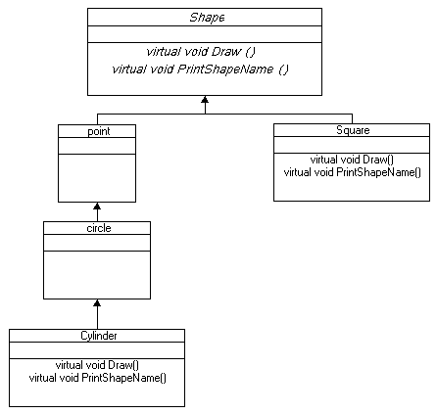
Polymorphism – Abstract Classes

Slide 45
Abstract shape class
class shape {
public:
virtual float area() const {return 0.0;}
virtual float volume() const {return 0.0;}
virtual void printShapeName()=0; //pure virtual
};

Slide 46
A concrete class
class square : public shape{
public:
square(float x=0); //Default constructor
void setside(float x);
float getside() const {return m_side;}
virtual void printShapeName(){cout << "Square: ";}
virtual float area() const {return(m_side*m_side);}
protected: //accessible only by derived classes
float m_side;
};

Slide 47
Code fragment illustrating polymorphism
void main()
{
int i;
shape *shapearray[3];
point p(2.1, 3.2);
circle c(3.2, 1.7, 3.9);
square s(4.5);
shapearray [0] = (shape *)&p;
shapearray [1] = (shape *)&c;
shapearray [2] = (shape *)&s;
for(i=0; i<3; i++)
{
cout << "Area of ";
shapearray[i]->printShapeName();
cout << shapearray[i]->area() << endl;
}
}

Slide 48
Abstract Classes and Virtual Functions
abstract class called shape which is inherited by two new shapes cylinder and square
since shape is abstract and it does not express a concrete realisation of a shape we cannot define the Draw method
  Draw function of the shape base class is said to be vitual

Slide 49
Polymorphic behaviour through abstraction
Virtual functions in an abstract base class.
  Desired behaviour obtained dyamically by selecting the correct methods for concrete realisations of a class
Method is defined in each of the derived classes.
In this sense a collection of objects referenced using the shape class exhibit polymorphic behaviour
  behaviour dependent on the specific methods defined for the derived classes.

Slide 50
Recommendation
Do not mix C and C++ Programming Styles
  External c libraries can still be called
For C++ programs use the ANSI C++ header nad not the ANSI C headers standard libraries
Keep things simple
  Build Create new classes when necessary
  Take care when using inheritance
Avoid re-inveting the wheel, use SDK’s
  See the code repository references below

Slide 51
Conclusion
Advantages
  Powerful development language for HPC applications
  Portable
  Reusable
  Requires careful design
  Wide range of libraries enabling high performance and rapid development.
Disadvantage
  Very easy to develop sloppy and inefficient code!!!!!!!!

Slide 52
References
http://www.cplusplus.com
Standard template libraries
  http://www.sgi.com/tech/stl/table_of_contents.html
Bjarn Stroustrups homepage
  http://www.research.att.com/~bs/homepage.html
Documentation for Sun Compilers
  http://developers.sun.com/prodtech/cc/compilers_index.html

Slide 53
Code Respositories
Github, googlecode
http://sourceforge.net/
http://www.netlib.org/
http://archive.devx.com/sourcebank/
http://www.boost.org/

